Slide 1


Hybrid Multi Cloud Computing
NITTE MEENAKSHI INSTITUTE OF TECHNOLOGY
Internship Presentation by
Anand D S 1NT17ECO11
Under the guidance of
Dr. Shashidhara K S

Slide 2
Contents
Cloud Computing
Types of cloud computing
Deployment Models
Hybrid Cloud Deployment
Amazon Web Services
Compute Services
Storage Services
Network Services
AWS EKS
OpenStack
What is OpenStack
OpenStack Components
Kubernetes
Kubernetes Cluster Architecture
Workload Resources
Network Resource – Services
Storage Resources
Terraform
Cloud Automation
How to use Terraform
Conclusion
DEMO – Configuring AWS web infrastructure using Terraform

Slide 3
Cloud Computing
Cloud computing is the delivery of different services through the Internet.
These resources include tools and applications like data storage, servers, databases, networking, and software.
Rather than keeping files on a proprietary hard drive or local storage device, cloud-based storage makes it possible to save them to a remote database.

Slide 4
Types of Cloud Computing
Software as a Service (SaaS)
Platform as a Service (PaaS)
Infrastructure as a Service (IaaS)
Software as a Service (SaaS)
All software and hardware is transparent
User only knows their own access point
Platform as a Service (PaaS)
Users are given software and hardware automatically
Infrastructure as a Service (IaaS)
Basic, service users maintain software

Slide 5
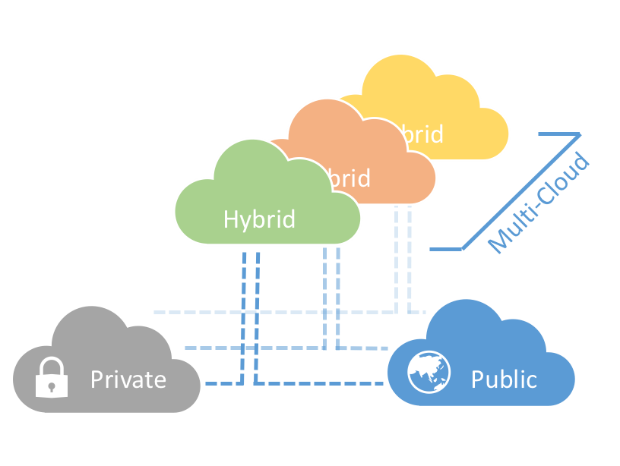
Cloud Deployment Models
PUBLIC CLOUD
Offered by third-party providers
Available to anyone over the public internet
Scales quickly and convenient
PRIVATE CLOUD
Offered to select users over the internet or a private internal network
Provides greater security controls
Requires traditional datacenter staffing and maintenance
HYBRID CLOUD
Combination of both public and private cloud
Shared security responsibility
Helps maintain tighter controls over sensitive data and processes

Slide 6
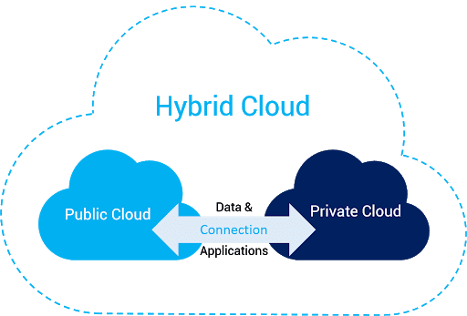
Hybrid Cloud Deployment
Hybrid Cloud is a combination of Private and Public Cloud.
Hybrid Cloud is essentially useful when some data cannot be put in cloud due to legal reasons.
We can deploy our website on a public cloud for leveraging salability advantages, and could deploy database in private cloud to secure the data.

Slide 7

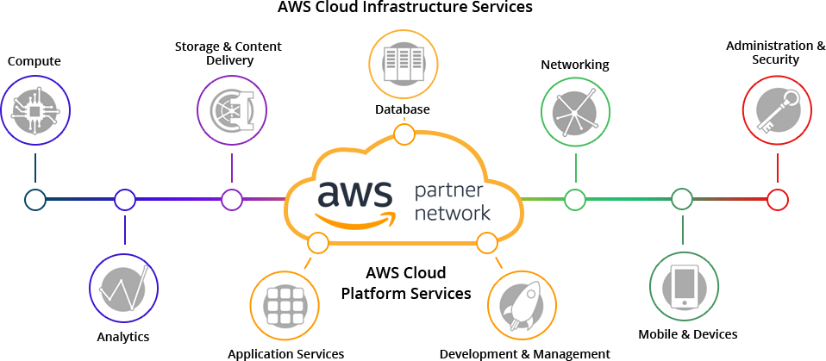
Amazon Web Services – .
Amazon Web Services (AWS) is a subsidiary of Amazon providing on-demand cloud computing platforms and APIs to individuals, companies, and governments, on a metered pay-as-you-go basis.

Slide 8
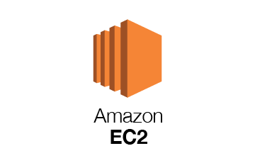
AWS EC2 – Compute Service
Amazon EC2 presents a true virtual computing environment, allowing you to use web service interfaces to launch instances with a variety of operating systems, load them with your custom application environment, manage your network’s access permissions, and run your image using as many or few systems as you desire.

Slide 9
AWS Storage Services
Elastic Block Storage
Provides block storage volumes for EC2 instances
It is a SAN-like storage and can be accessed by only one instance.
Elastic File Storage
Provides a scalable network file storage for EC2 instances
It is a NAS-like storage and can be accessed by multiple instances at same time
Simple Storage Service
Provides a scalable and durable object storage in the cloud.
It is a disk based storage, data is stored as objects in buckets.

Slide 10
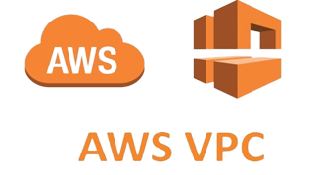
AWS VPC – Network Service
Virtual Private Cloud (Amazon VPC) is a service that lets you launch AWS resources in a logically isolated virtual network that you define.
You have complete control over your virtual networking environment, including selection of your own IP address range, creation of subnets, and configuration of route tables and network gateways.
Amazon VPC is the networking layer for Amazon EC2. The following are the key concepts for VPCs:
Virtual private cloud
Subnet
Route table
Internet gateway
NAT gateway
VPC endpoint

Slide 11
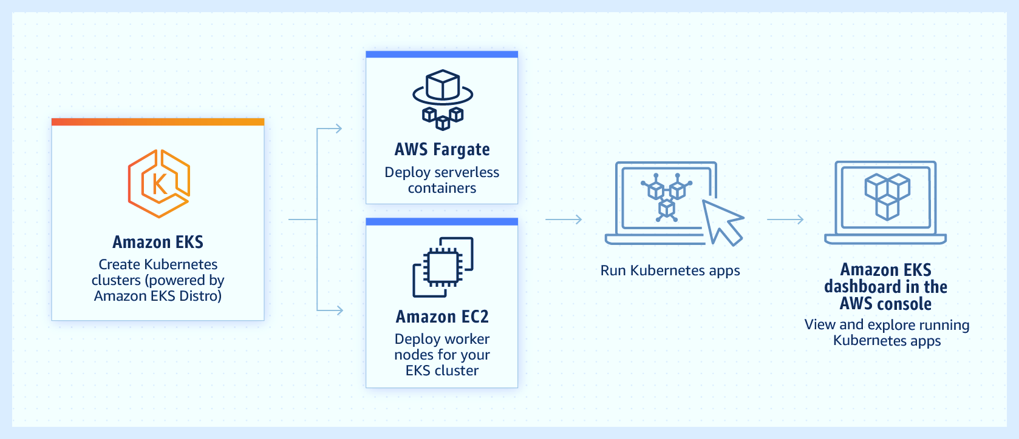
Amazon EKS - Managed Kubernetes Service

Slide 12
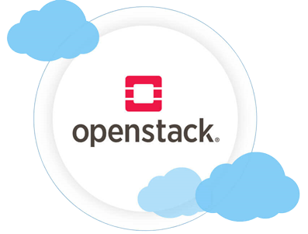
OpenStack – Private Cloud Platform
OpenStack is a free open source cloud computing platform, mostly deployed as infrastructure-as-a-service (IaaS) for private clouds where virtual servers and other resources are made available to users.
OpenStack is a cloud operating system that controls large pools of compute, storage, and networking resources throughout a datacentre, all managed and provisioned through APIs with common authentication mechanisms.
A dashboard is also available, giving administrators control while empowering their users to provision resources through a web interface.

Slide 13
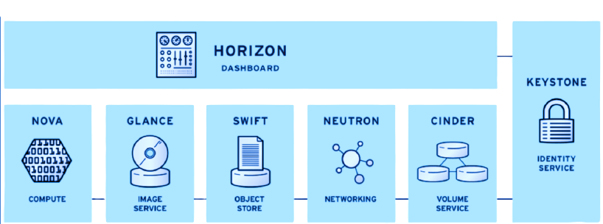
OpenStack Components
There are 6 stable, core services that handle compute, networking, storage, identity, and images while more than a dozen optional ones vary in developmental maturity.
* NOVA – Compute Service * NEUTRON – Network Service
* SWIFT – Object Storage Service * CINDER – Block Storage Service
* KEYSTONE – Authentication Service * GLANCE – Image Service

Slide 14
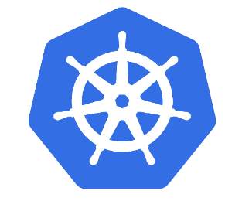
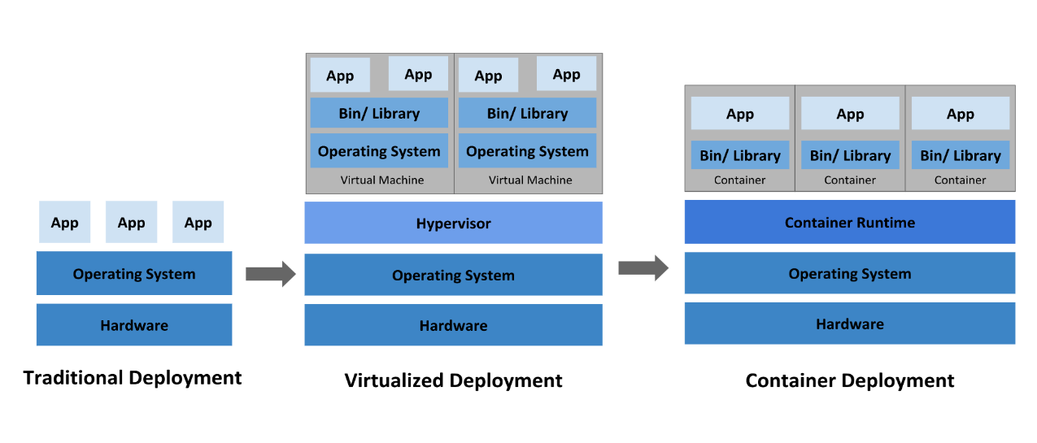
Kubernetes
Kubernetes, also known as K8s, is an open-source system for automating deployment, scaling, and management of containerized applications.
Containers are similar to VMs, but they have relaxed isolation properties to share the Operating System (OS) among the applications.

Slide 15
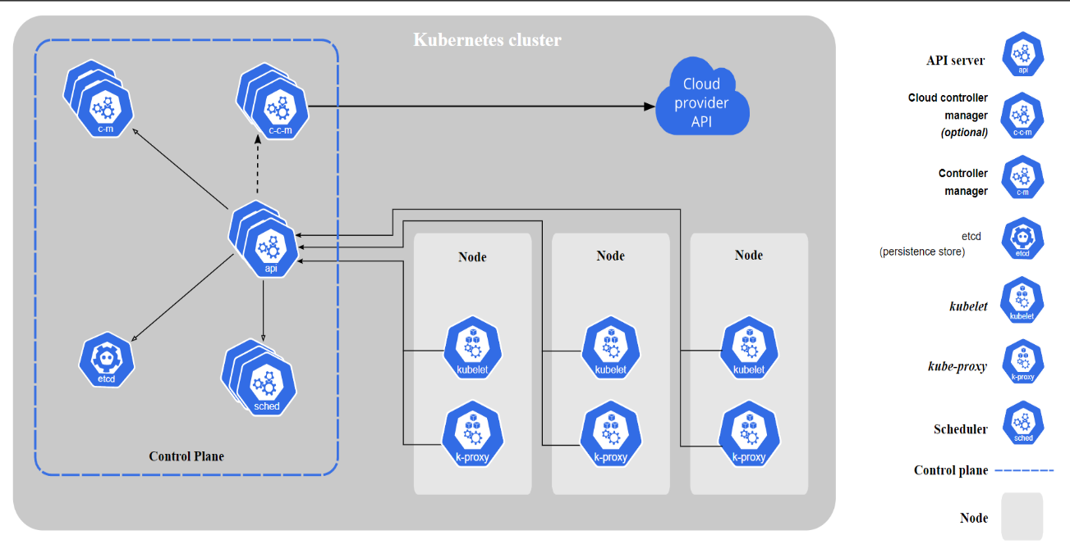
Kubernetes Cluster Architecture

Slide 16
Kubernetes Workload Resources
- Deployment
Deployments are a higher level management mechanism that provides declarative updates for Pods and ReplicaSets.
- ReplicaSets
A ReplicaSet's purpose is to maintain a stable set of replica Pods running at any given time.
It is often used to guarantee the availability of a specified number of identical Pods.
- Pods
Pods are the smallest deployable units of computing that you can create and manage in K8s
A Pod is a group of one or more containers, with shared storage and network resources, and a specification of the containers.
Deployments will manage what happens to the ReplicaSet - whether an update has to be rolled out, or rolled back

Slide 17
Kubernetes Network Resources
Service
An abstract way to expose an application running on a set of Pods as a network service.
Kubernetes gives Pods their own IP addresses and a single DNS name for a set of Pods, and can load-balance across them.
Service
Type NodePort
Type LoadBalancer
Type NodePort
Using a NodePort gives you the freedom to set up your own load balancing solution, to configure environments that are not fully supported by Kubernetes, or even to just expose one or more node’s IPs directly.
Type LoadBalancer
On cloud providers which support external load balancers, setting the type field to LoadBalancer provisions a load balancer for your Service.

Slide 18
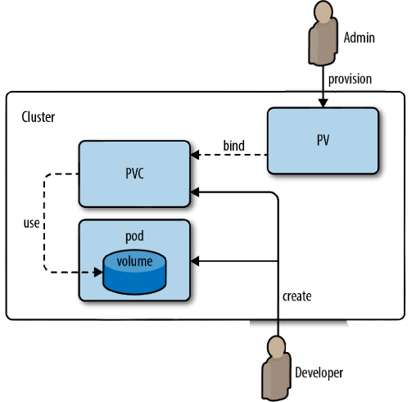
Kubernetes Storage Resources
PersistentVolume (PV)
A PersistentVolume (PV) is a piece of storage in the cluster that has been provisioned by an administrator or dynamically provisioned using Storage Classes.
PersistentVolumeClaim (PVC)
A PersistentVolumeClaim (PVC) is a request for storage by a user. It is similar to a Pod. Pods consume node resources and PVCs consume PV resources. Claims can request specific size and access modes

Slide 19
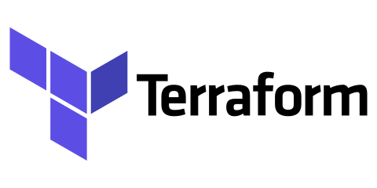
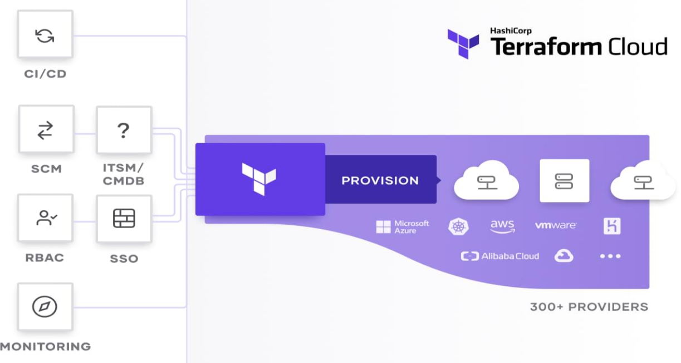
Cloud Automation using
Terraform is an open-source infrastructure as code software tool that provides a consistent CLI workflow to manage hundreds of cloud services. It is a tool for building, changing, and versioning infrastructure safely and efficiently.
Terraform generates an execution plan describing what it will do to reach the desired state, and then executes it to build the described infrastructure.
As the configuration changes, Terraform is able to determine what changed and create incremental execution plans which can be applied.

Slide 20
How to use Terraform
Terraform Cloud provides remote operations for Terraform, and is ideal for production and team environments
Terraform has four major commands:
$ terraform init
$ terraform plan
$ terraform apply
$ terraform destroy
Write
Compose
Plan
Provision & Manage
1. Create new infrastructure using HCL
2. Connect a workspace to a Terraform configuration stored locally
3. Terraform Cloud provides a plan for infrastructure changes before every run.
4. Provision and manage infrastructure reliably and securely with Terraform Cloud’s run environment.

Slide 21


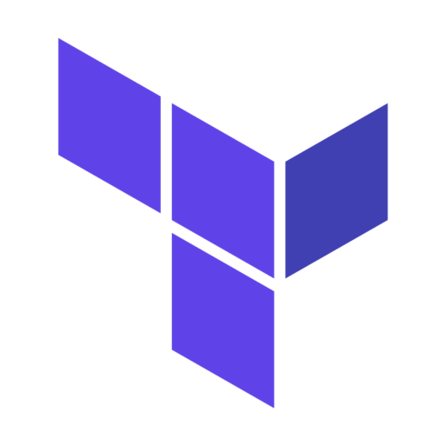
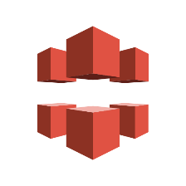
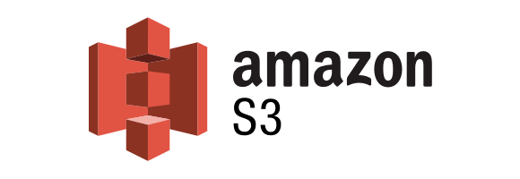
DEMO – Configuring AWS web infrastructure using Terraform
WebApp
+
Source Code & Images
Amazon
EBS
Source Code
(git clone)
CDN URLs
of Images
CloudFront
Images upload to S3

Slide 22
Thank You

